Slide 1


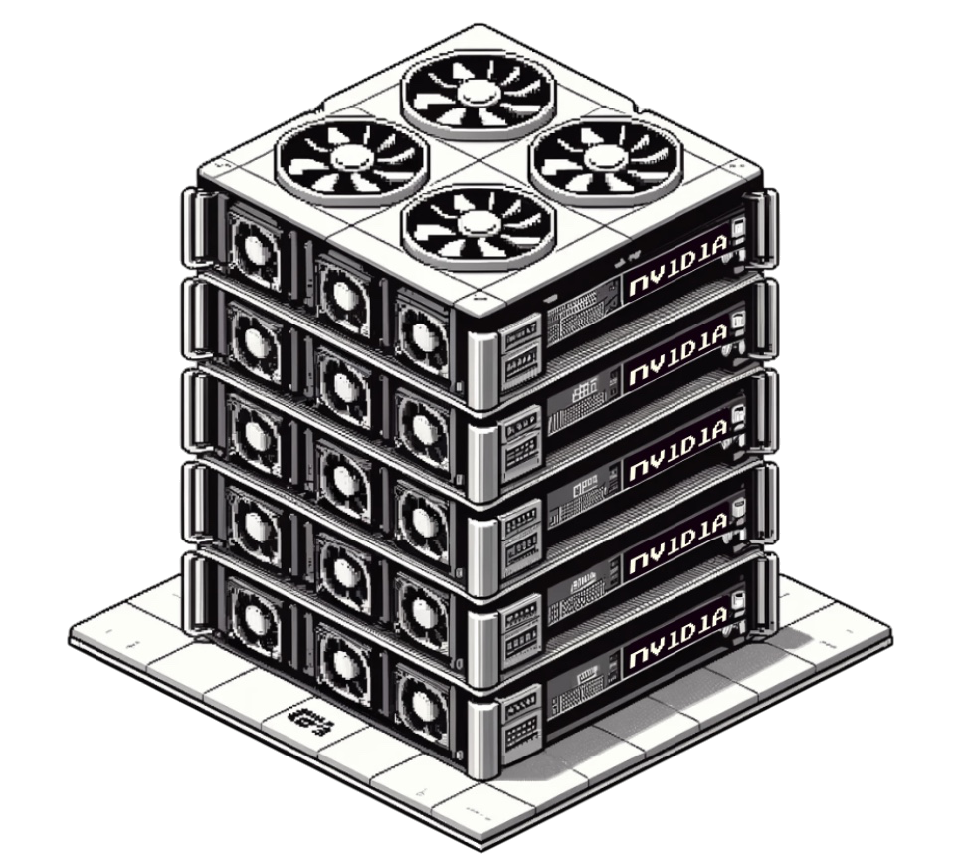
TRITON
GROK FLASH ATTENTOIN
Spring 2025 CS6140 Final Project
Group Members: Joey Cherisea, Jane Feng, Nuanxin Jin, Yincong Lu
Page 01

Slide 2

TABLE OF CONTENT
Motivation
Related Works
The math
dataset
Experiments
Discussion
Future Works

Slide 3
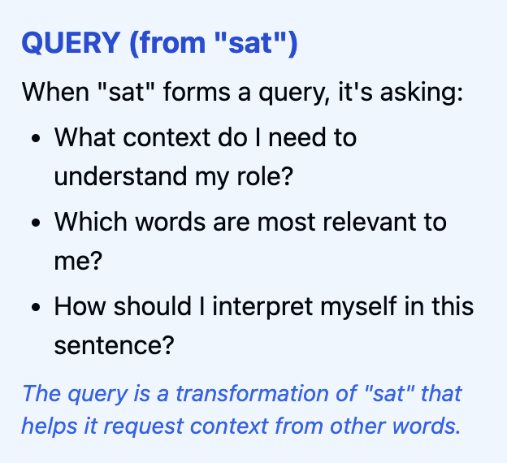
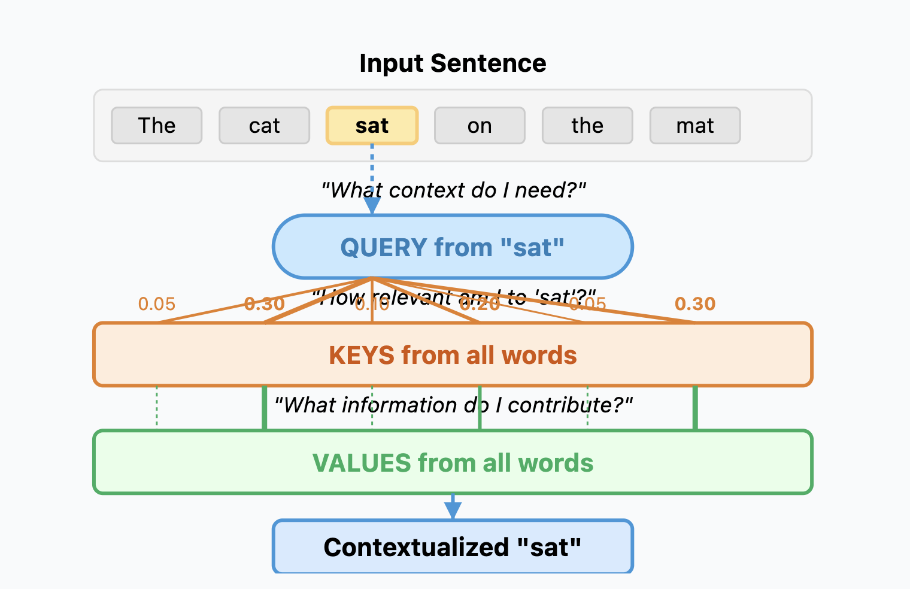
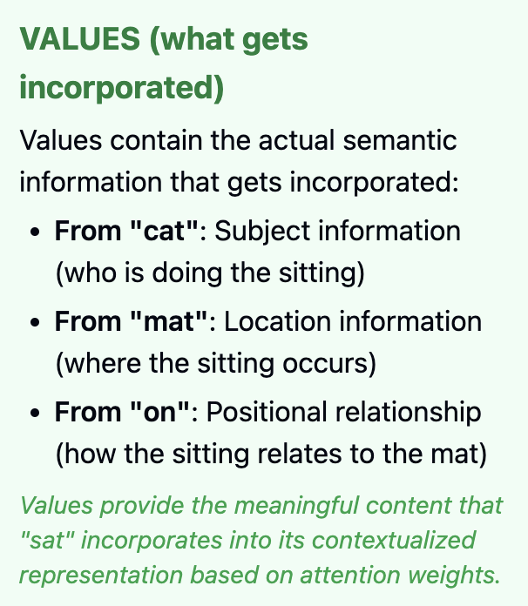
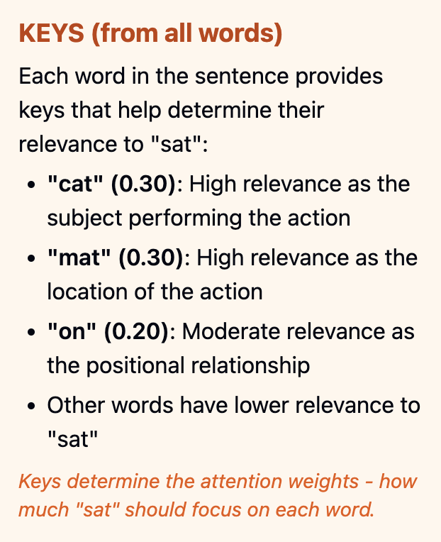
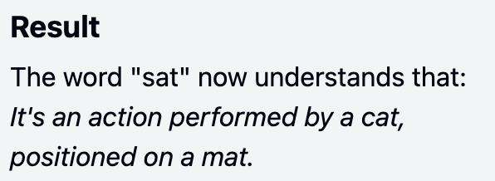

Slide 4
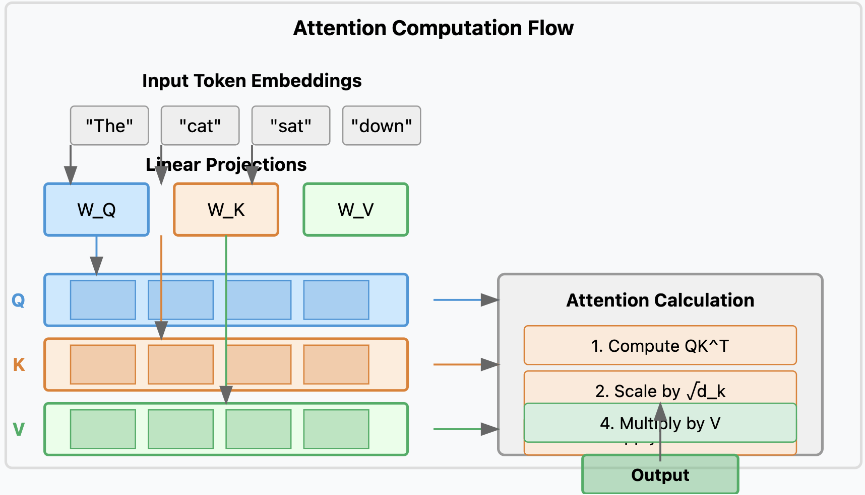

Slide 5
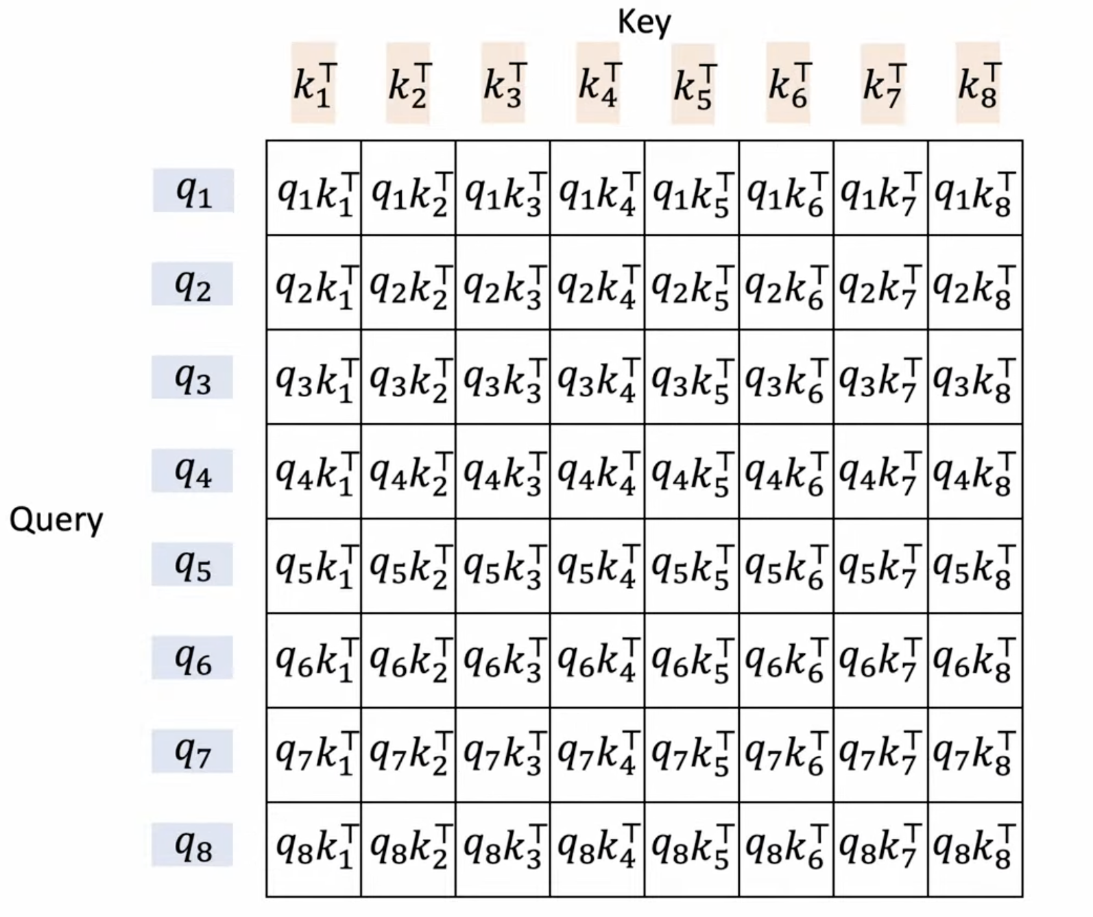
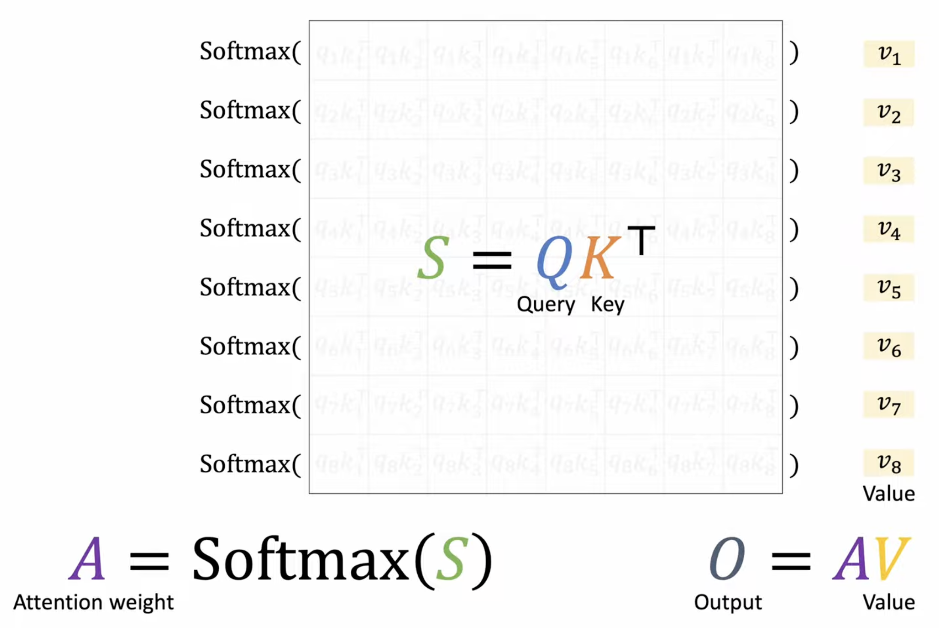
MOTIVATION
Foundation of modern AI: Attention is the cornerstone of transformer architectures powering LLMs like GPT, Claude, and BERT
Computational bottleneck: As model sizes grow, attention computation becomes increasingly expensive
Processing sequences of length N requires O(N²) memory and computation
For a 2048-token sequence: ~4 million attention pairs per head
Modern models have dozens of attention heads across numerous layers

Slide 6
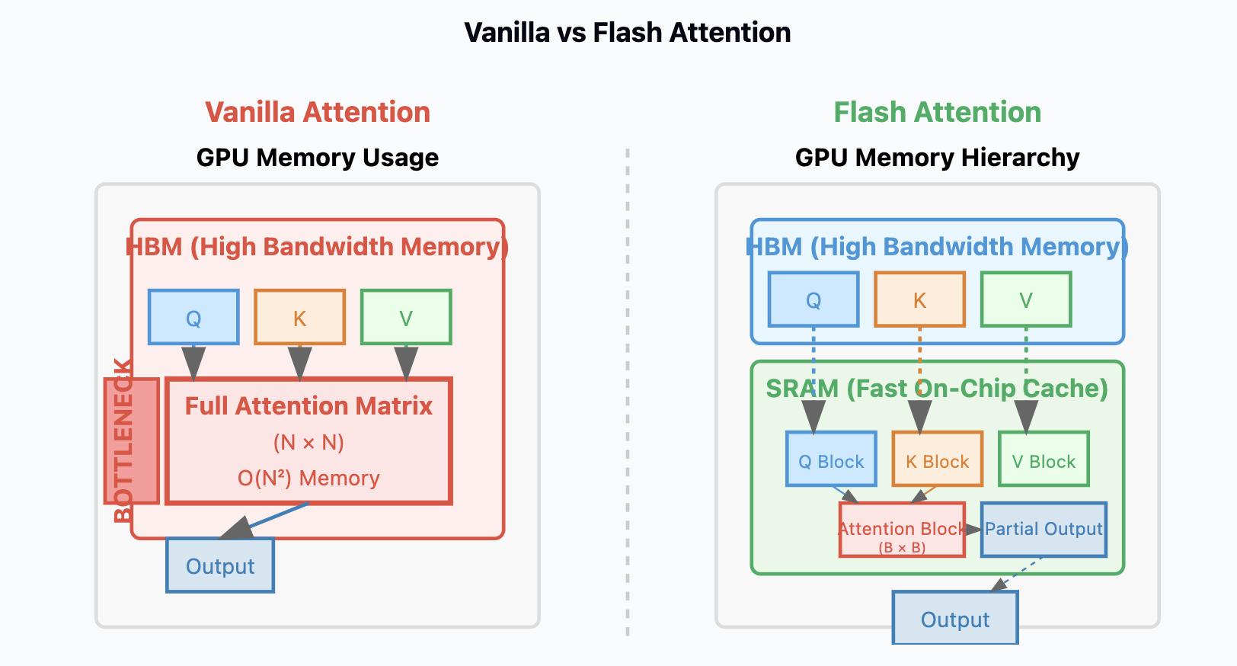
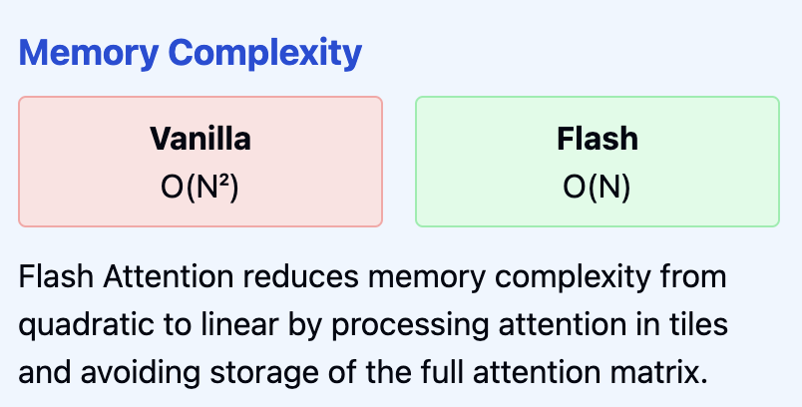
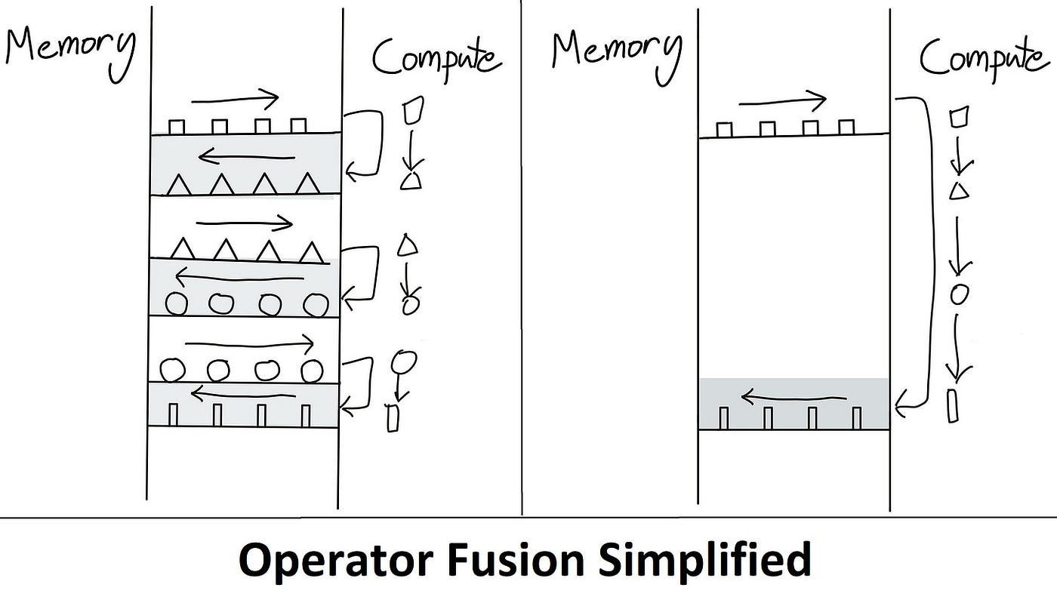
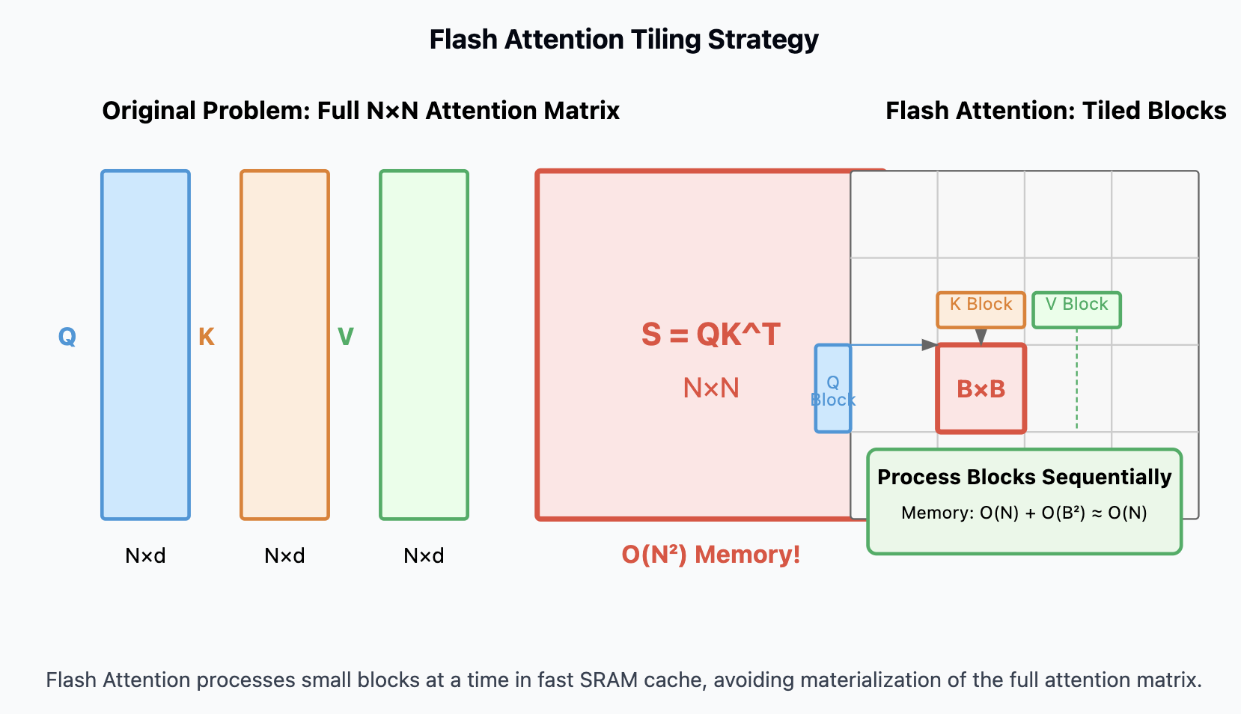
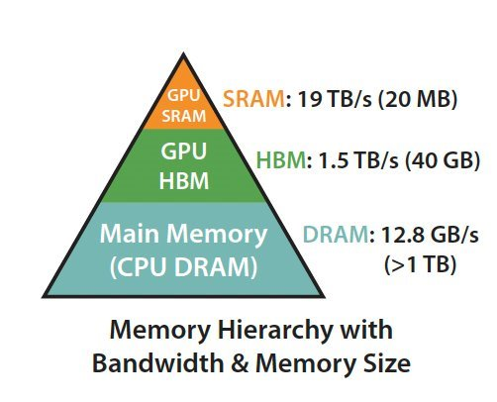

Slide 7
Related Works
In older RNN models, the whole input sentence was squeezed into just one final hidden state to make predictions. Especially with long sentences, earlier words could be forgotten.
Attention minimized the risk of losing information by allowing the model to look at all the words in the input, not just the last one. Using a bidirectional RNN, it captures context from both earlier and later words to better understand each word’s meaning. Then, it calculates attention weights to figure out which input words are most relevant at each step.
2014 - Bahdanau et al.
“Neural Machine Translation by Jointly Learning to Align and Translate”
Self-attention operates directly on input embeddings (such as word vectors), rather than on hidden states like in RNNs. It takes a single input sequence (e.g., a sentence) and compares each word to every other word in the sequence to determine which ones are most relevant. This comparison is done using dot products, followed by softmax to produce attention weights.
2017 - Vaswani et al.
“Attention Is All You Need”
Flash attention improves the efficiency of calculating attention scores by reducing memory overhead without changing the results. Unlike the original 2017 self-attention, which stores large intermediate matrices and performs costly memory operations, Flash Attention uses tiling to process attention in small blocks .
2022 - Dao et al.
“FlashAttention: Fast and Memory-Efficient Exact Attention with IO-Awareness”

Slide 8

THE MATH
Tiling
How to avoid matrix materialization by
dividing it into tiles
Online Softmax
Fast and accurate softmax computation without
matrix materialization

Slide 9
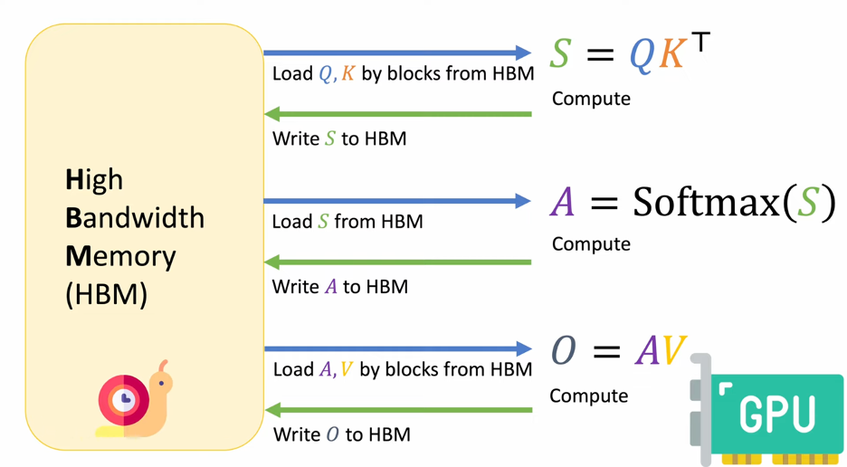
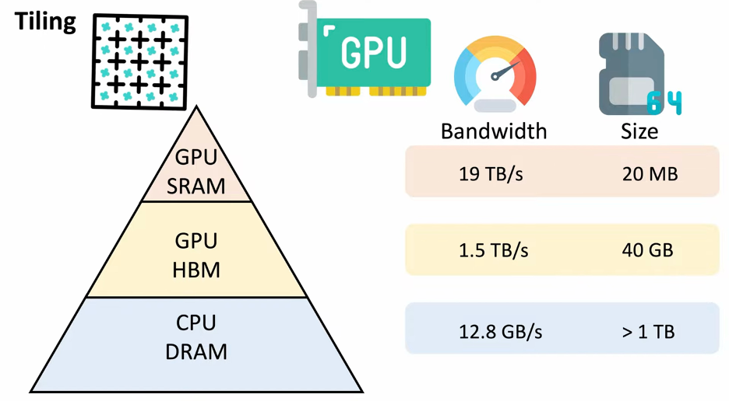
TILING
Notes:
As we can see data frequently travel back and forth between the hbm and the GPU core, and it cause the Global memory adds significant latencies. That‘s why we need some optimization approach like flash attention.

Slide 10
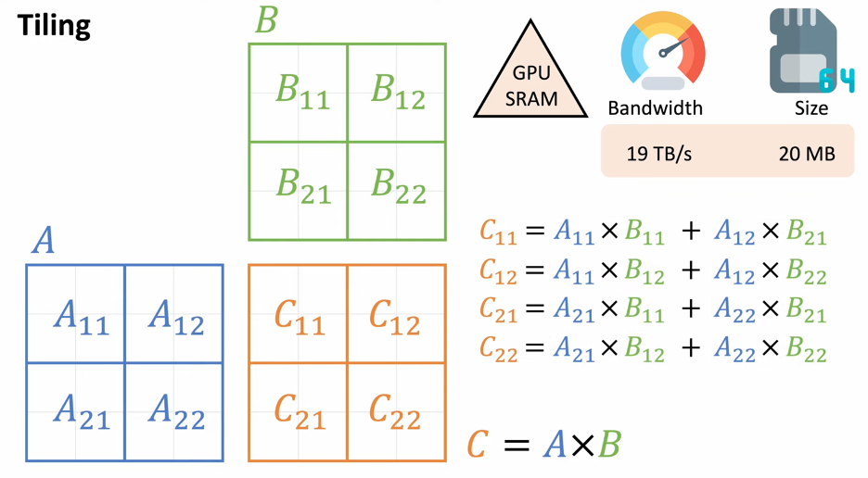
TILING
Notes:
Tiling is an IO optimization technique that can use SRAM effectively. Instead of loading and multiplying entire matrices, we divide them into smaller submatrices or tiles. Like in this graph, matrix A is split into four blocks, and similarly for B. If we make the tile size small enough, can compute each tile of the result matrix C directly in fast memory. When all the computing can be done in SRAM instead of HBM, the memory needs to read and write full matrices can be reduce significantly and leading to much faster computation.

Slide 11
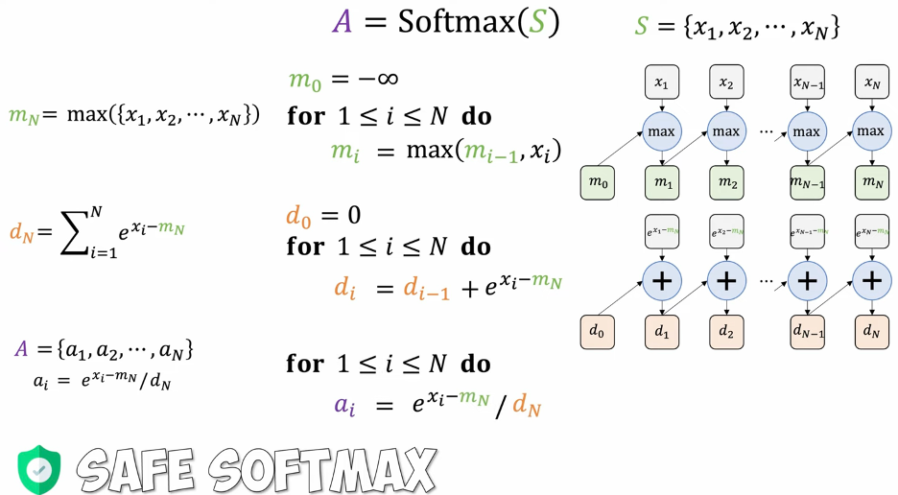
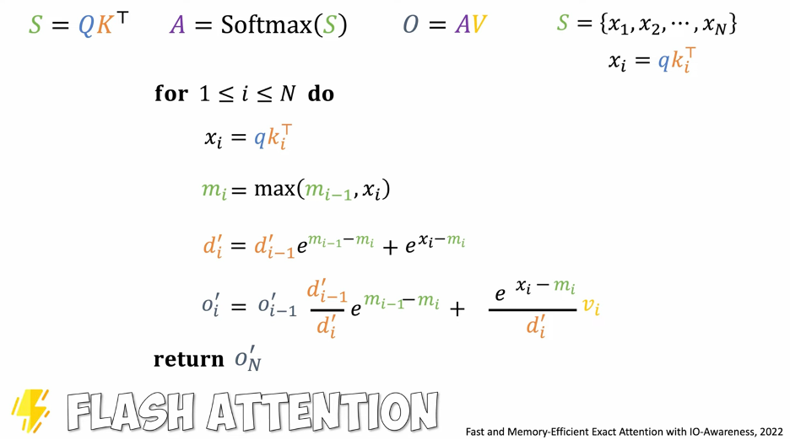
Online Softmax
Safe SoftMax
Find the maximum score across the row
Subtract maximum from each element and compute exponentials
Normalize by dividing each exponential by their sum
Online SoftMax
Process scores incrementally, one at a time
Update running max and SoftMax denominator dynamically
Accumulate output without storing full scores
Notes:
But tiling alone isn’t enough — Flash Attention also needs a new way to compute softmax.
The standard method, known as Safe Softmax, involves three steps:
1. Find the maximum score in the row
2. Subtract it from each value and take the exponentials
3. Normalize by dividing each exponential by their sum
This only works when all scores are available at once. In Flash Attention, we process scores block by block, so we can’t see the full row.
That’s where Online Softmax comes in.Instead of waiting for all scores, we process them one at a time.At each step:
• We update the running maximum mₖ
• Update a scaled denominator dₖ′
• And accumulate the output oₖ′
There’s no need to store all scores or attention weights. Once all tiles are processed, the final output oₙ′ is exactly the same as the result of full softmax.

Slide 12
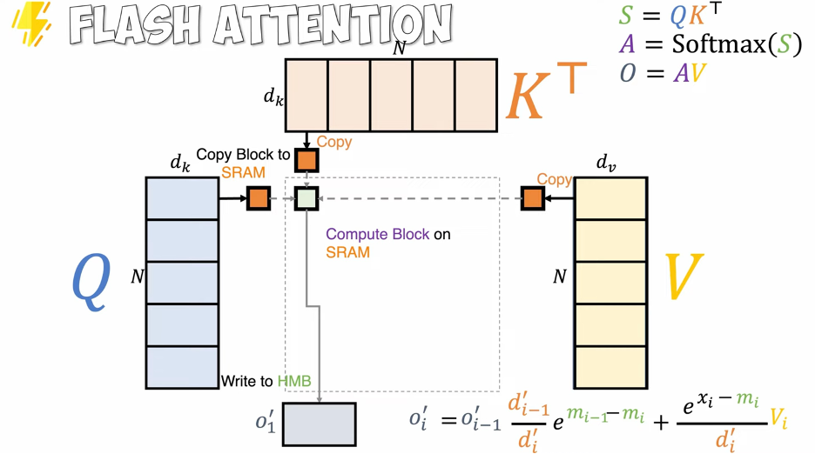
Flash Attention
Notes:
Now that we understand tiling and Online Softmax, let’s see how it all fits together.
Flash Attention loads small blocks of Q and K into SRAM to compute partial scores. These are immediately used to compute partial outputs with V, all done in SRAM. Only the final results are stored in HBM. The attention matrix QKᵀ or softmax matrix A is never materialized.This pipelined and memory-efficient design is what makes Flash Attention both fast and scalable.

Slide 13
DATASET
4D synthetic data with a shape: (batch_size, num_heads, seq_len, head_dim)
Batch Size | 4 | 4 | 4 | 4
Number of Attention Heads | 8 | 8 | 8 | 8
Sequence Length | 512 | 1024 | 2048 | 4056
Head Dimension | 64 | 128 | 256 | 512
Note: experiment data are sampled from a standard normal distribution(mean 0 and standard deviation 1) using torch.randn.

Slide 14
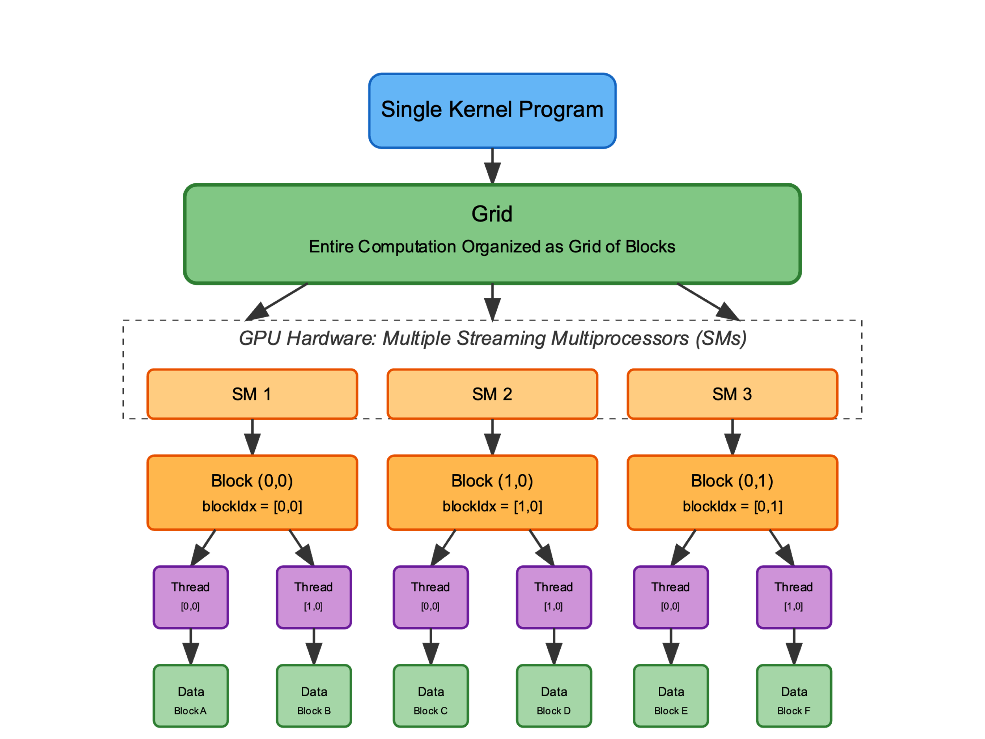
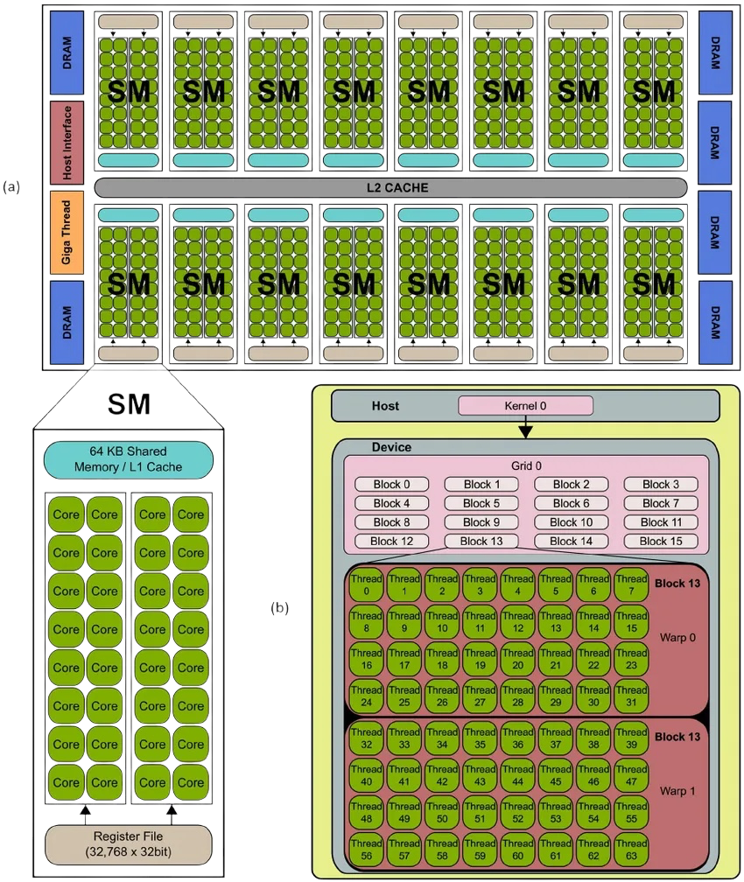
EXPERIMENTS
Triton SPMD Paradigm
GPU Components
source: researchgate.net/figure/Typical-NVIDIA-GPU-architecture-The-GPU-is-comprised-of-a-set-of-Streaming_fig1_236666656
Notes:
Before diving into experiments, I think it’s necessary to briefly introduce how Triton works as a programing language. One notable feature is that it follows a single-program-multiple-data paradigm to take full advantage of parallelism. A program is usually launched on a 3D execution grid. It then gets dispatched to multiple SMs that consists of a bunch of blocks. These blocks are further broken down into warps, which are groups of threads. Finally, the smallest processing unit thread will handle different chunks of data in parallel.
To map these concept to the underlying hardware, we have a pic on the right that illustrates typical GPU components. SM, short for streaming multiprocessor, is the fundamental unit in GPU. It consists of several cores, which is the smallest compute unit, and memory units such as register file and L1 cache. While subgraph b shows how GPU resources are controlled by programmers through CUDA programming model.

Slide 15
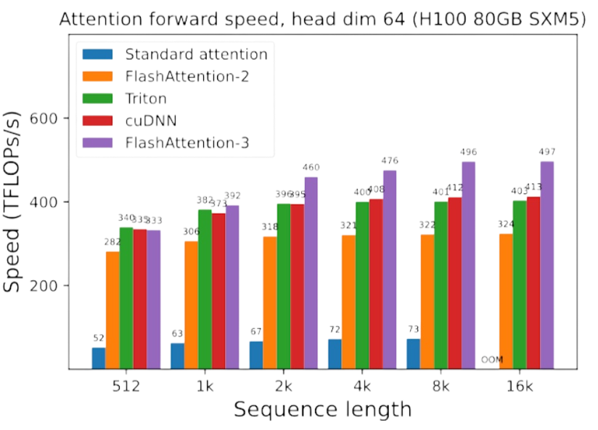
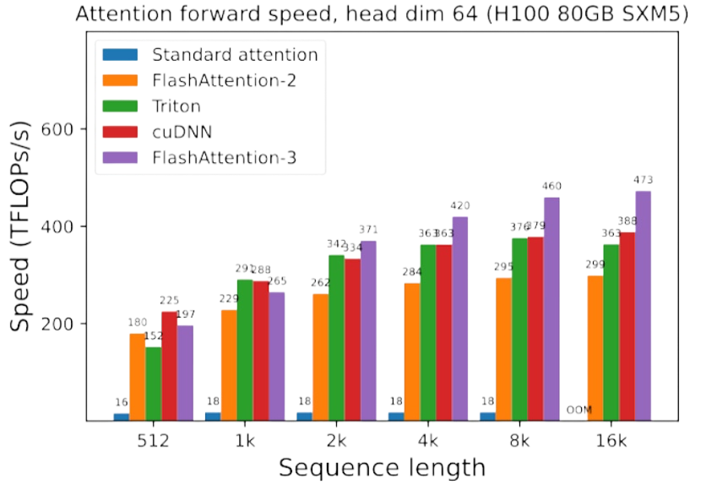
Forward without casual mask
Forward with casual mask
[1] Pytorch. “FlashAttention-3: Fast and Accurate Attention with Asynchrony and Low-Precision.” PyTorch, 2024, pytorch.org/blog/flashattention-3/. Accessed 14 Apr. 2025.

Slide 16
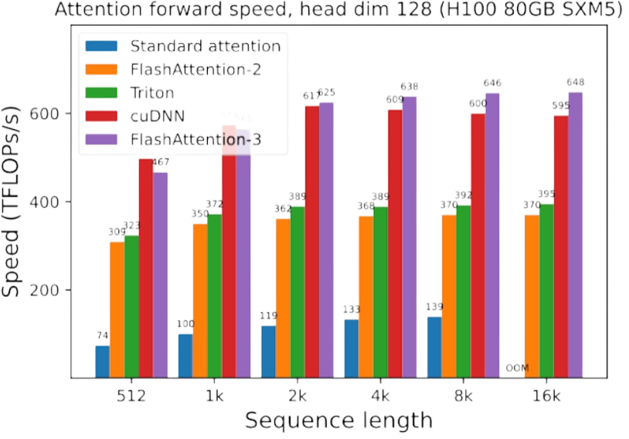
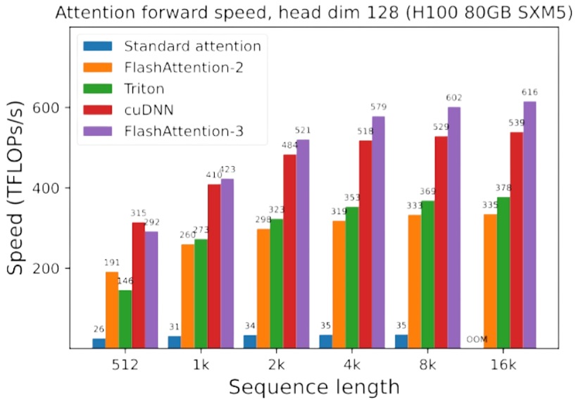
Forward without casual mask
Forward with casual mask
[1] Pytorch. “FlashAttention-3: Fast and Accurate Attention with Asynchrony and Low-Precision.” PyTorch, 2024, pytorch.org/blog/flashattention-3/. Accessed 14 Apr. 2025.

Slide 17
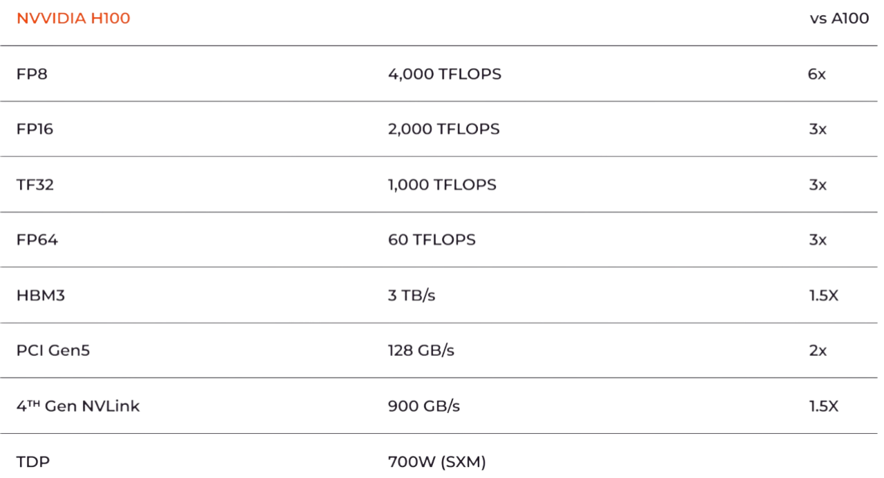
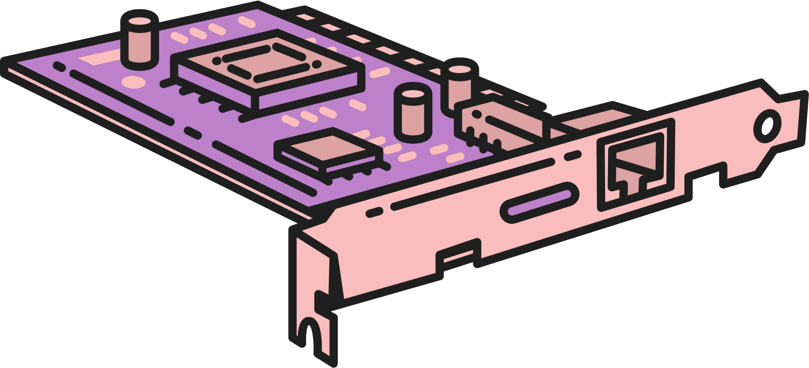
DISCUSSION
Hardware constraint
Data Shape: (4, 8, 512, 32) GPU: Colab A100 RAM 40GB
Execution Time: 34m
Performance comparison shows H100 exceeds A100 performance by a factor of 1.5x to 6x

Slide 18

Financial constraint
Shoutout to Professor Aanchan for his support
 | Google Colab | Digital Ocean
A100 | $1.5/hr | N/A
H100 | N/A | $3.39/hr

Slide 19


FUTURE
WORKS
Flash Attention 2&3
Backward Pass
Explore the upgraded versions of flash attention that takes better advantage of Nvidia GPU hardware
Examine the backward pass of various types of attention mechanism

Slide 20


THANK YOU

Slide 21


APPENDIX

Slide 22
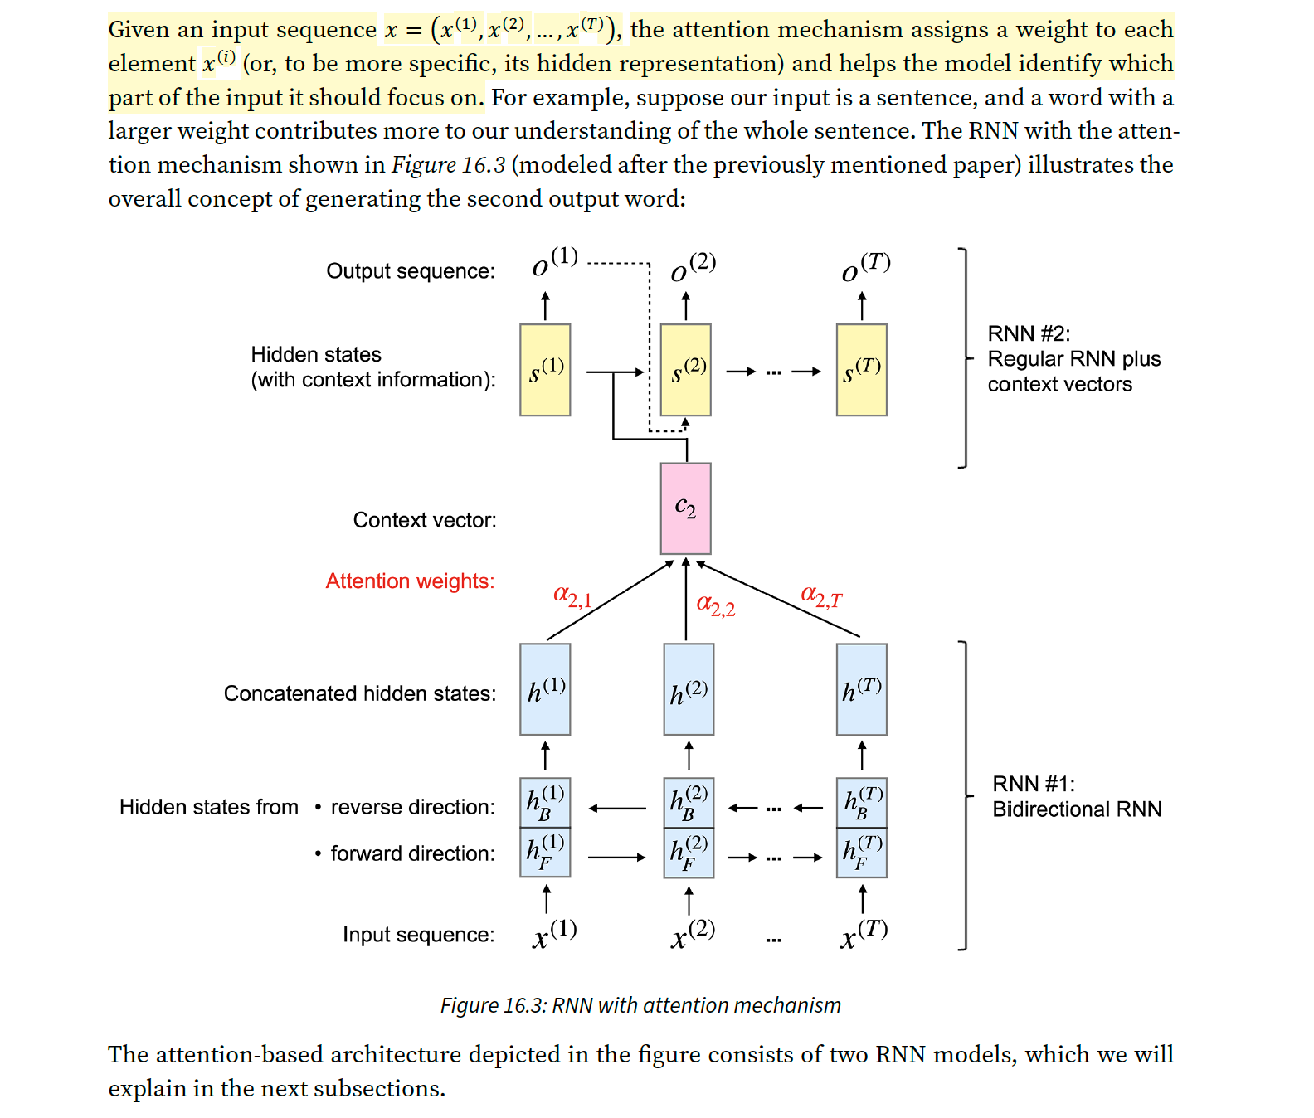
2014 - Bahdanau et al
Previously in sequence models like RNNs, the final hidden state (from the last word) was used to summarize the entire input sentence and generate the output. But this caused problems for long sentences, because earlier information could be forgotten.
Each input word is processed using a bidirectional RNN, which captures information from both the left (past) and right (future), creating hidden states like h(1), h(2), ..., h(T) by concatenating forward and backward states.
At each output step (e.g., generating the second word), the model computes attention scores (α₂,₁, α₂,₂, ..., α₂,T) for each input hidden state, showing how relevant each one is to the current output word.
These scores are used to create a context vector c₂, which is a weighted sum of the input hidden states.
This context vector is then used along with the decoder’s state to produce the output word O(2).

Slide 23
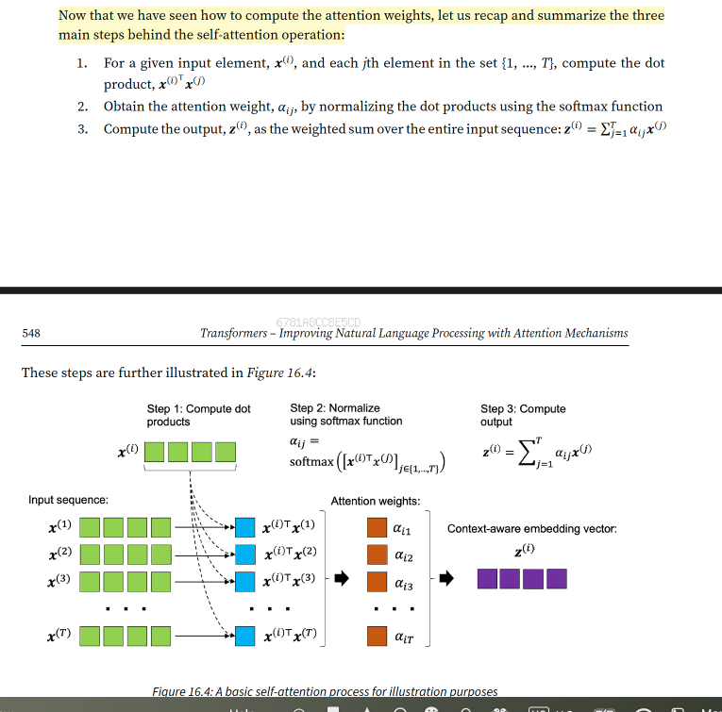
2017 - Vaswani et al. “Attention Is All You Need”
Self-attention in the Transformer allows each input token to compute a weighted representation of all other tokens in the same input sequence. The 2017 paper outlines this through three key steps, which are illustrated in the diagram:
Compute Dot Products: For each input token, we compare it to every other token in the same sequence by computing the dot product between their projected vectors (queries and keys). Since both sets (queries and keys) come from the same sequence, this forms a matrix of attention scores where each token "attends" to every other token — including itself.
Apply Softmax: These raw dot product scores are passed through a softmax function, turning them into attention weights — a probability distribution that highlights which tokens are most relevant to each one.
Weighted Sum of Values: Finally, each token computes its output vector by taking a weighted sum of the value vectors, using the attention weights from step 2. This results in a context-aware embedding, where each token now reflects information from the entire sequence.

